Slide 1
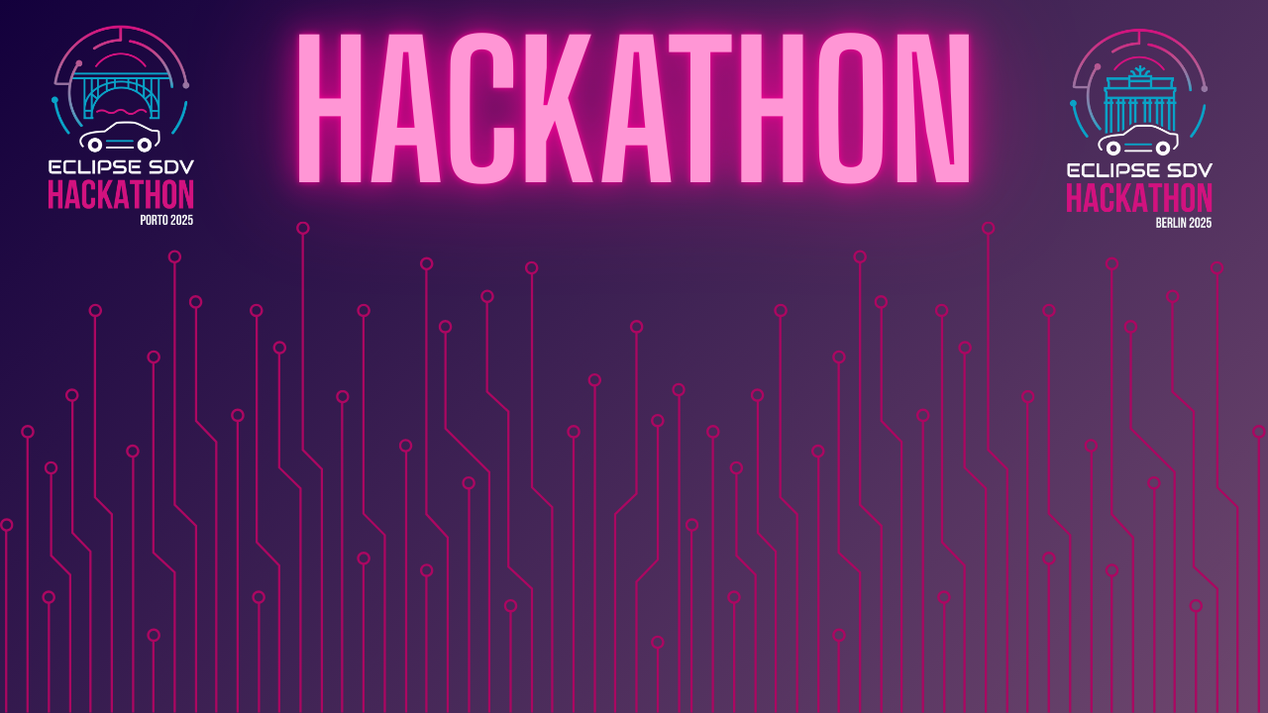

Chapter III - 2025
COPYRIGHT (C) 2025, ECLIPSE FOUNDATION

Slide 2
SDVenturers
COPYRIGHT (C) 2025, ECLIPSE FOUNDATION

Slide 3

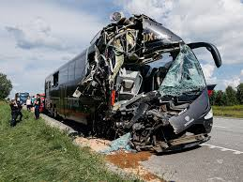
Every year, road traffic crashes claim 1.19 million lives and injure 20-50 million more – with fatigue, distraction, and aggression driving up to 25% of fatalities. [https://www.who.int/news-room/fact-sheets/detail/road-traffic-injuries]

Slide 4
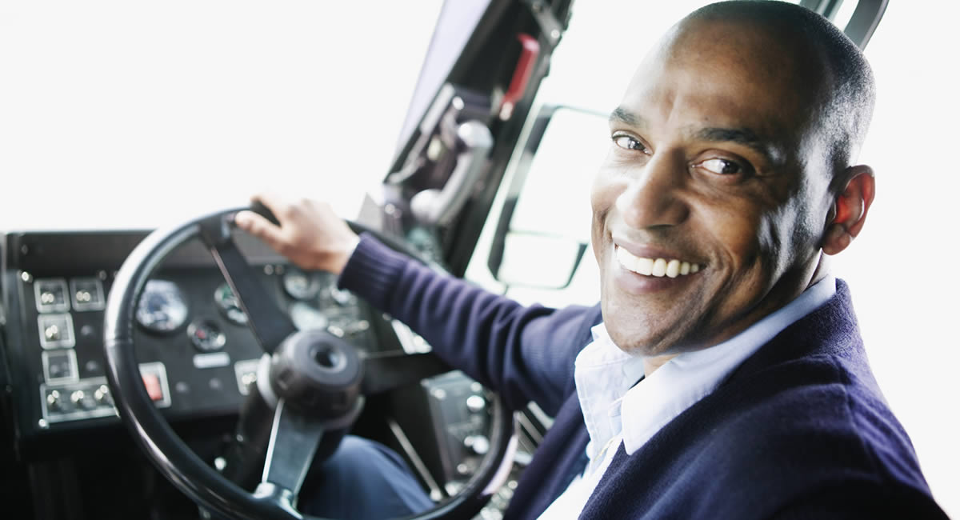
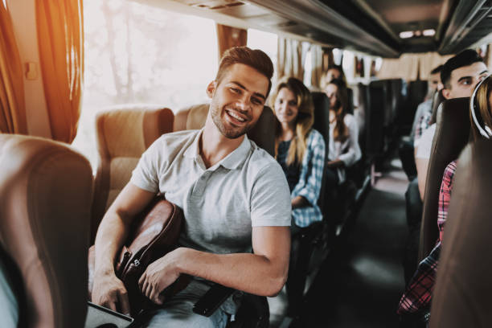
Mood Detection and Action
With new GSR regulations, vehicles must monitor the driver’s condition. Today’s systems mostly detect drowsiness, but they cannot understand the emotional state of the driver.
Our plan is to go further:
Use cameras and sensors to detect if the driver is angry, stressed, or calm. Process this data on the vehicle’s HPC in real time.
Give simple feedback to the driver and control the vehicle:
If angry or tired → vehicle gets eco mode
If calm → city mode
Mood gets detected → Vehicle control reacts
→ Non-ignorable feedback for the driver

Slide 5
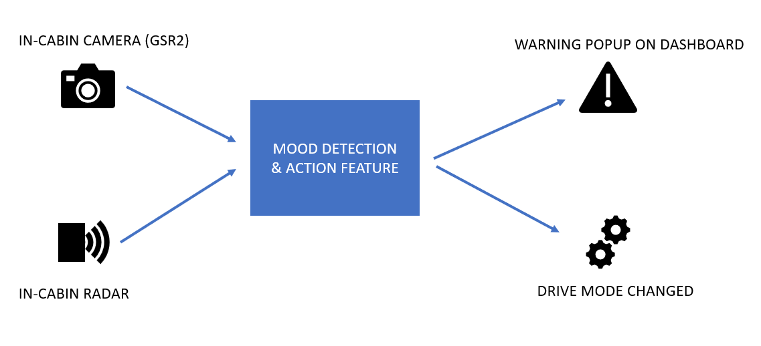
The System Architecture

Slide 6
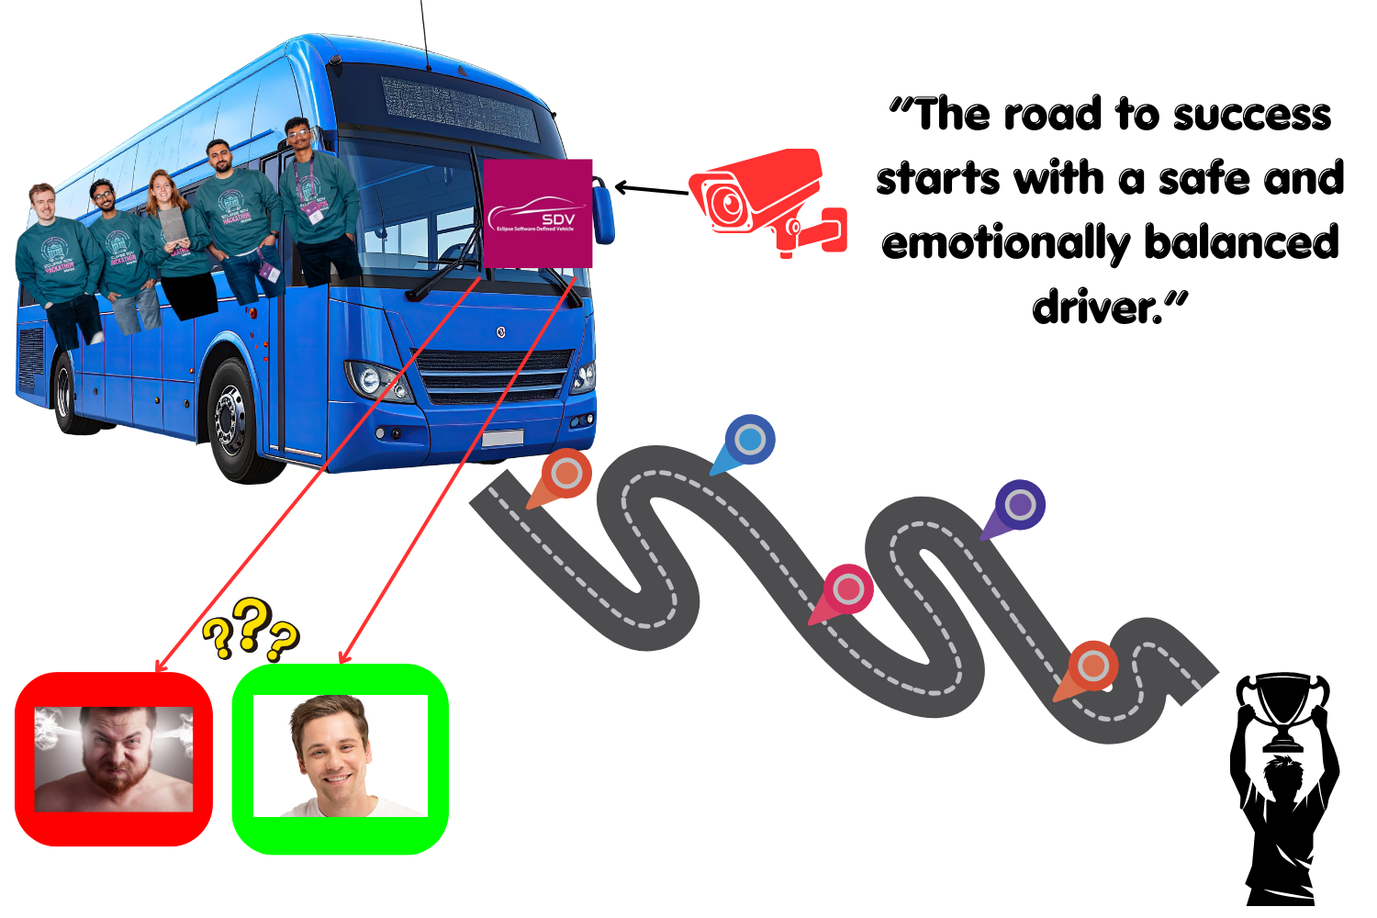
The Added Value
Goes beyond GSR compliance (not only drowsiness, but also emotional state monitoring).
Provides a holistic view of the driver → detects stress, anger, sadness, or fatigue in real time.
People-oriented solution → designed for commercial buses where passenger safety is critical.
Adds proactive safety feedback (rest, end shift, continue safely) instead of just passive alerts.
Uses open-source Eclipse technologies (Mosquitto, uProtocol, Ankaios, ThreadX) → scalable, interoperable, and future-proof.

Slide 7
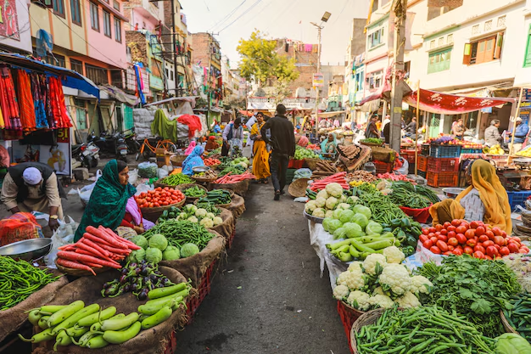
The Market & The Competition
Existing Competitors:
Smart Eye, Eyeris, Lytx, OEM Driver Monitoring Systems
Focus mainly on drowsiness and distraction detection(DDAW, ADDW)
Limitations:
Limited or no emotional state analysis
Mostly regulation-driven, not proactive feedback
Some are research prototypes, not market-ready
Our Differentiation:
Detects emotions (angry, stressed, calm, happy)
Provides real-time actionable feedback and takes action based on mood (adjust vehicle behaviour)
People-oriented → focuses on both driver well-being & passenger safety
Built with open Eclipse technologies → scalable, interoperable, future-proof

Slide 8
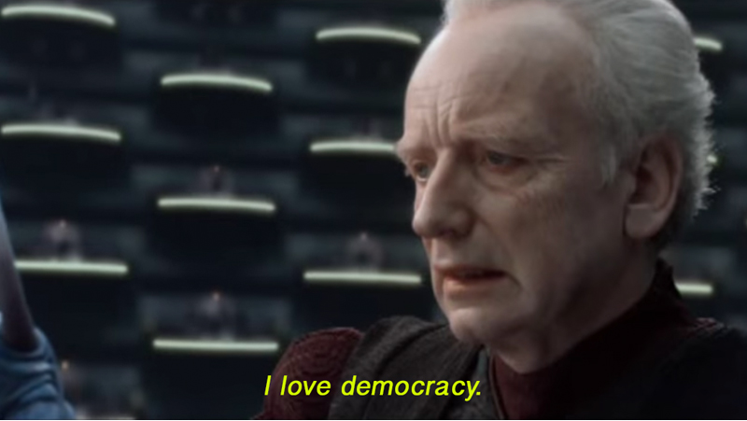
Team and Structure
Pascal Kneuper : System Build, System Integration, Software Development
Aniket Barve : System Build, System Integration, Software Development
Adarsh Rastogi : System Build, System Integration, Software Development
Tessa Talsma : System Build, System Integration, Software Development
Batuhan Arslan : System Build, System Integration, Software Development

Slide 9
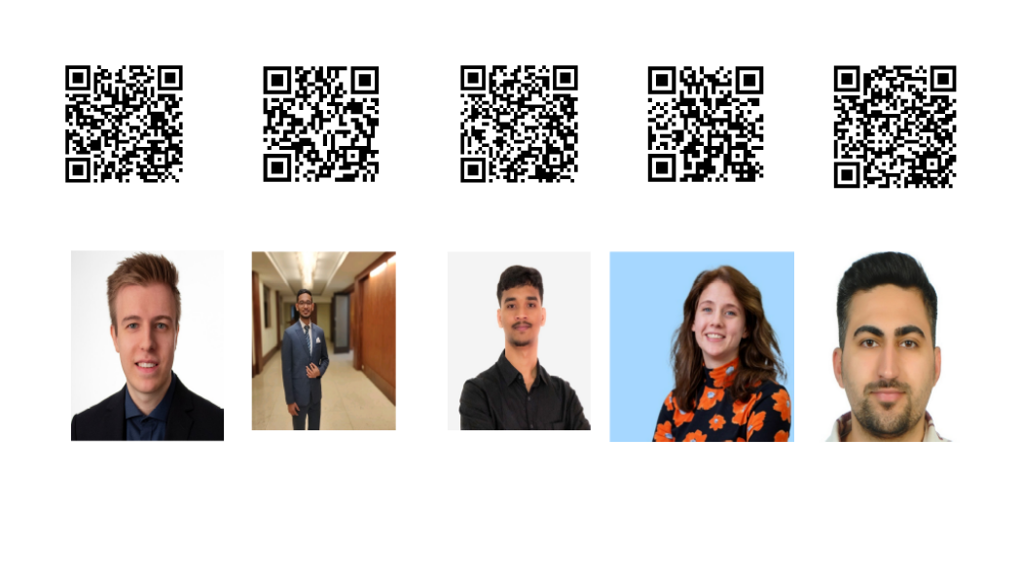
Contact

Slide 10
Thank your audience and encourage them to get in touch afterwards.
COPYRIGHT (C) 2025, ECLIPSE FOUNDATION

